Slide 1

Major Project: Seasonal Agriculture Performance Analysis
Neethu Raj K R
-Mar Gregorios Memorial College of
Engineering and Pharmaceutical Science ,Valanchery
AICTE STU ID : (STU679ce056f167b1738334294)

Slide 2

PROBLEM STATEMENT
(Agricultural activities are influenced by seasonal variations in environmental conditions, farming practices, resource availability and market conditions. As a result, agricultural performance may differ from one season to another. However, raw agricultural data does not clearly explain how agricultural performance changes across seasons or what patterns can be observed in different seasonal conditions. The problem is to analyze the given agricultural dataset and investigate seasonal differences in agricultural performance by identifying meaningful patterns, trends, relationships and variations within the available data.

Slide 3
Project Description
Analyze 4,000 agricultural records covering 8 states, 10 districts, 8 crops and 3 seasons: Kharif, Rabi and Zaid.
Clean and prepare the dataset by checking missing values and applying median imputation to selected numerical fields.
Compare seasonal yield, production, environmental conditions, resource usage and economic outcomes.
Use grouped summaries, bar charts, box-style comparisons, correlation analysis and crop/region comparisons to identify patterns.
Translate the observed evidence into conclusions and practical recommendations for seasonal agricultural planning.

Slide 4

WHO ARE THE END USERS?
Farmers and farm managers – to compare seasonal yield, resource needs and profitability.
Agricultural planners and extension officers – to support evidence-based seasonal planning.
Government and policy stakeholders – to understand regional and seasonal agricultural patterns.
Agribusiness and resource managers – to evaluate production, water use and economic performance.
Students and data analysts – to demonstrate practical agricultural data analytics.

Slide 5

Technology Used
Python – core analysis and data processing
Pandas – data cleaning, grouping and aggregation
NumPy – numerical operations
Matplotlib / Seaborn – statistical and analytical visualizations
Google Colab – interactive analysis and documentation
CSV dataset – source data for seasonal agriculture analysis

Slide 6
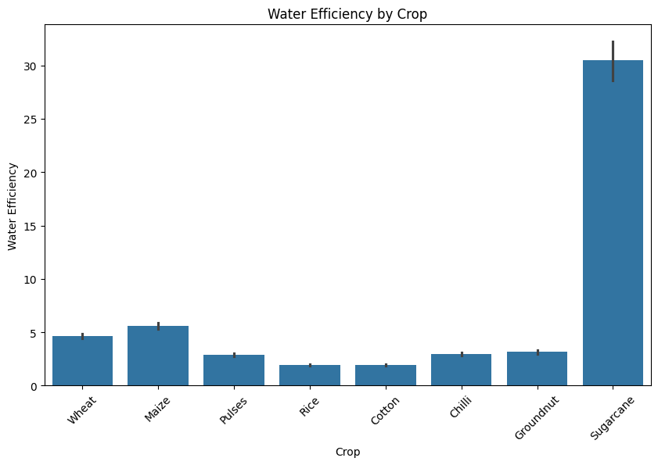
RESULTS
-Which crops have the best water efficiency?

Slide 7
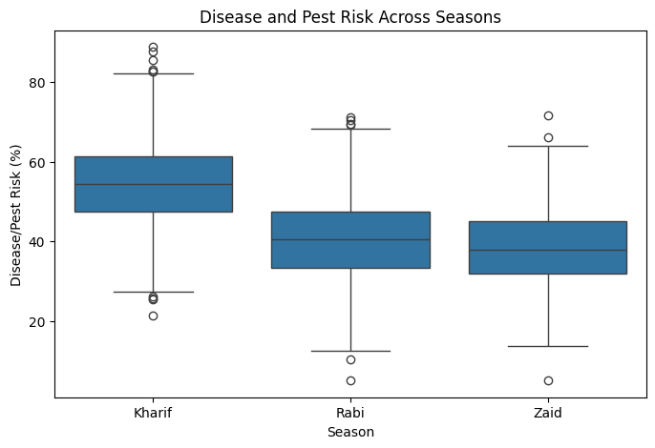
RESULTS
- How does disease/pest risk vary across seasons?

Slide 8
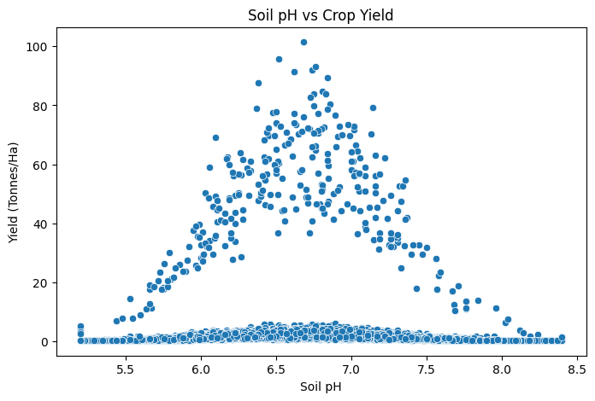
RESULTS
- Does soil pH affect crop yield?

Slide 9
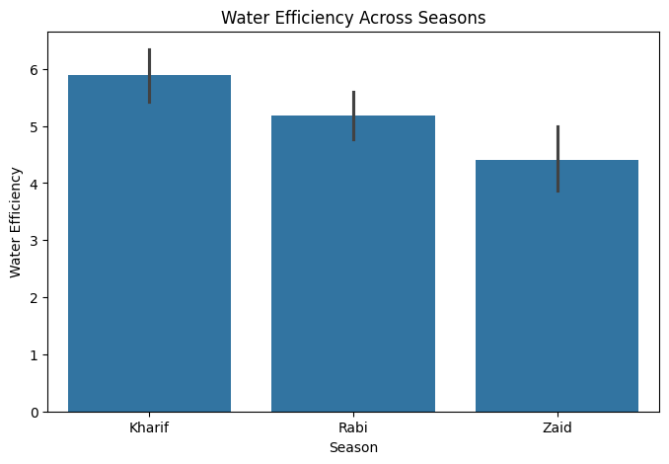
RESULTS
- How does water efficiency differ among seasons?

Slide 10
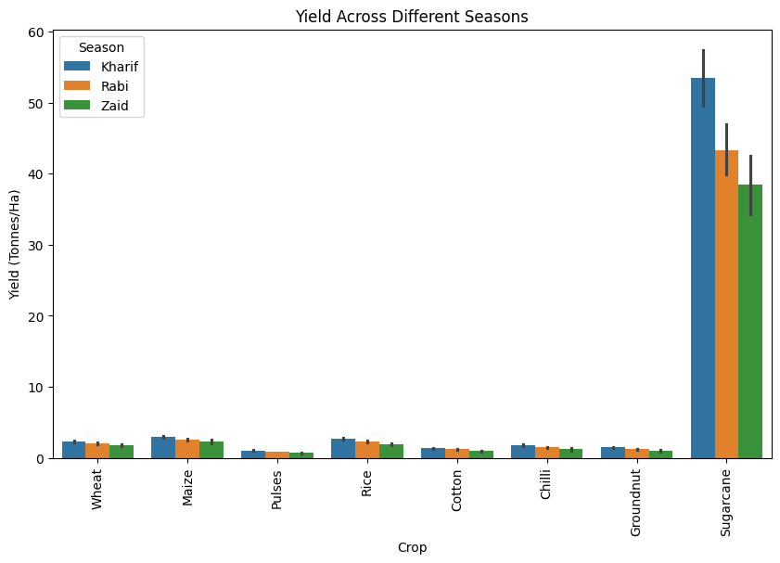
RESULTS
- Yield Across Different Seasons

Slide 11
Future scope
Build predictive models for crop yield and seasonal profitability.
Add multi-year time-series data to study long-term seasonal trends and climate variability.
Use district-level weather and soil data to improve localized recommendations.
Develop an interactive dashboard for farmers, planners and policymakers.
Investigate crop-specific resource optimization and irrigation efficiency.
Extend anomaly detection to identify high-risk seasons, districts or crop combinations.

Slide 12
GitHub Link
https://github.com/Neethu-raj-konthath/Neethu_Raj_Seasonal_agricaltural_performance_analysis.ipynb/blob/main/Neethu_Raj_Seasonal_agricaltural_performance_analysis.ipynb

Slide 13
VOIS Course completion certificate -
Course name- Data Visualization

Slide 14
Thank you
.
.

